Slide 1
HOT SPOTS OF INDIA
THE AREAS THAT ARE EXTREMELY RICH IN BIODIVERSITY,HAVE HIGH LEVEL OF ENDEMISM,AND ARE UNDER CONSTANT THREAT OF SPECIES EXTINCTIONS AND HABITAT DESTRUCTION ARE CALLED “HOT SPOTS” OF BIODIVERSITY.
THE CONCEPT OF HOTSPOTS WAS FIRST PROPOSED BY NORMAN MEYERS IN 1988.
FOR DECLARING AN AREA AS HOTSPOT,SOME CRITERIA ARE
1.ATLEAST 0.5% SPECIES,IDENTIFIED GLOBALLY AS ENDEMIC SPECIES MUST BE PRESENT IN THAT HABITAT.

Slide 2
2.ATLEAST 1500 LOCAL SPECIES MUST BE PRESENT.
OR 3.NEARLY 70% OF THE NATURAL HABITAT MUST HAVE UNDERGONE LARGE SCALE CHANGES.
WORLDWIDE,25 HOTSPOTS ARE IDENTIFIED.
INDIA HAS THREE MAJOR CENTRES NAMELY 1.HIMALAYAS,2.WESTERN GHATS,3.ANDAMAN AND NICOBAR ISLANDS.

Slide 3
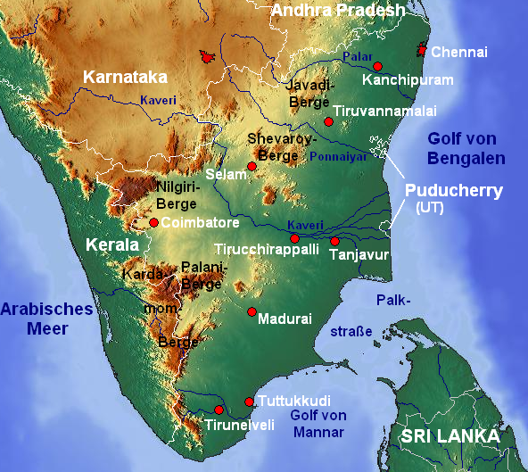
WESTERN GHATS

Slide 4
WESTERN GHATS OR SAHYADRI HILLS RUN PARALLEL TO WESTERN COAST OF THE INDIAN PENINSULA.IT IS UNESCO WORLD HERITAGE SITE AND ONE OF THE EIGHT HOTTEST SPOTS OF BIOLOGICAL DIVERSITY.
STARTS NEAR THE BOARDER OF GUJARAT AND MAHARASHTRA,SOUTH OF TAPTI RIVER AND RUNS APPROXIMATELY 1600KM(990 MILES) THROUGH KARNATAKA,GOA,MAHARASHTRA,KERALA & TAMILANADU,ENDING AT KANYAKUMARI.
IT PREVENTS SOUTHEAST MONSOON WINDS FROM REACHING DECCAN PLATEAU.

Slide 5
FLOWERING PLANTS—7,402SPS
NON-FLOWERING PLANTS---1,814SPS
MAMMALS----139SPS
BIRDS---508SPS
AMPHIBIANS----179SPS
INSECTS----6000SPS
FRESH WATER FISH----290SPS
325 GLOBALLY THREATENED SPS OCCUR IN WESTERN GHATS.
LARGE POPULATION OF ASIAN ELEPHANTS,INDIAN TIGERS AND LONG TAILED MONKEYS LIVE HERE.

Slide 6
ANNUAL RAINFALL,TEMPERATURE AND MOISTURE LEVELS ARE HIGH.SO EVERGREEN FORESTS DEVELOP.FORESTS ARE CLASSIFIED INTO 1.TROPICAL MOIST EVERGREEN FORESTS,2.MIXED DECIDUOUS FORESTS,3.TEMPERATE EVERGREEN FORESTS, 4.COASTAL/MANGROOVE FORESTS.
THE TROPICAL MOIST FORESTS CONTAIN TALL TREES SUCH AS DIPTEROCARPUS INDICUS,CEDRELLA TOONA,DALBERGIA LATIFOLIA,TECTONA GRANDIS, AND BAMBOOS.
THE MALABAR AREA IS RICH IN PIPER SPS, MYRISTICA SPS,ELETTARIA SPS,CINNAMOMUM SPS,ZINGEBAR SPS,CURCUMA SPS.

Slide 7
AGASTHAMALAI HAS EVERGREEN FORESTS WHICH CONTAIN NEARLY 150 LOCAL SPS AND PLANTS LIKE EUGENIA FACEOSA,DIOSPYROS BARBERI etc.
ARECENT STUDY OF WAYNAD PART PROVED THAT THE BIODIVERSITY OF THE REGION IS STILL NOT EXPLORED FULLY.
2100 FLOWERING PLANTS HAVE BEEN IDENTIFIED BY M.S.SWAMINATHAN FOUNDATION.SEVEN OF THEM ARE FRESH DISCOVERIES,INCLUDING IMPATIENS VEERAPAZHASSI,I.JENKURUMBAE,I.MALABARICA, I.MEENAE,CEROPEGIA MANOHARII,MILIUSA WYNADIA,MEMECYLEN WYNADEUSIS.

Slide 8
SILENT VALLEY SPREAD OVER 90 SQUARE KILOMETERS AND IS KNOWN HOME FOR A NO. OF TROPICAL FORMS.
BISCHOFIA,CALOPHYLLUM,CULLENIA WILD VARIETIES OF PEPPER,CARDAMUM AND MUSA ARE FOUND HERE.
B.S.I HAS RECORDED 1600 FLOWERING PLANTS FROM THIS AREA.
ALONG PERIYAR RIVER,CLOVES,CINNAMOMUM ARE PRESENT.
CONSTRUCTION OF DAMS,POWER PROJECTS, CUTTING FORESTS FOR AGRICULTURE ARE THE MAIN CAUSES FOR THE DESTRUCTION OF THE BIODIVERSITY IN THIS AREA.

Slide 9
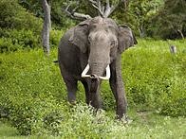

Slide 10
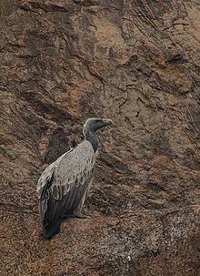
INDIAN VULTURE

Slide 11
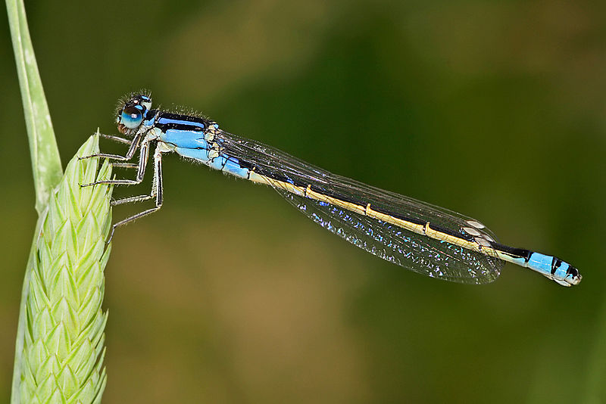
ISCHNURA HETEROSTICTA

Slide 12
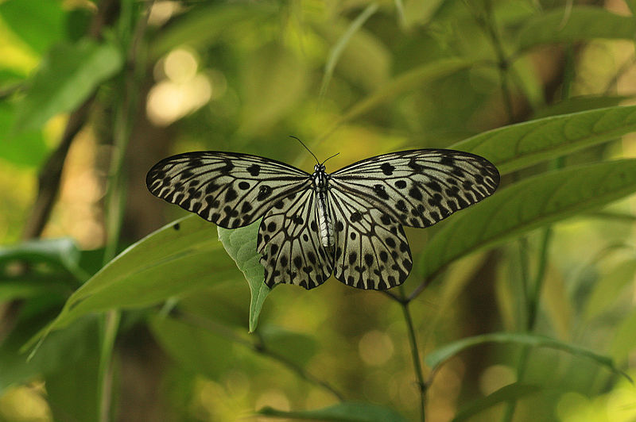
MALABAR TREE NYMPH

Slide 13
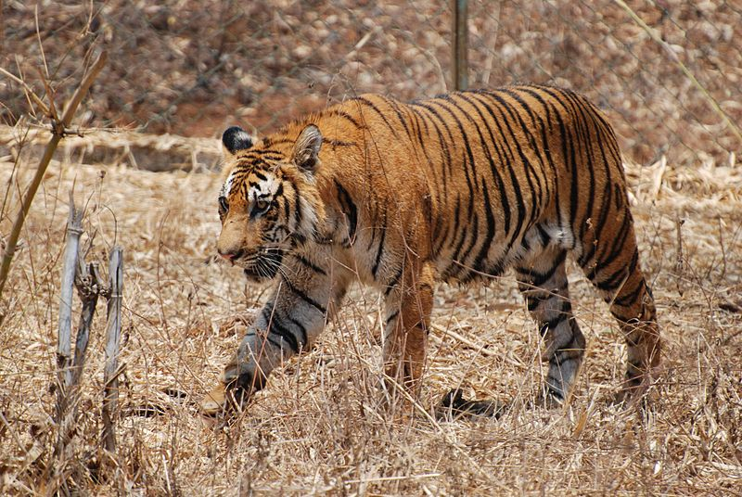
BENGAL TIGER --KARNATAKA

Slide 14
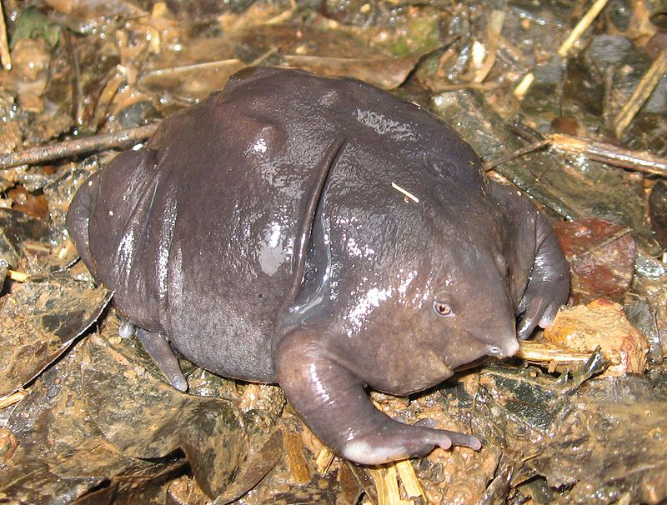
PURPLE FROG

Slide 15
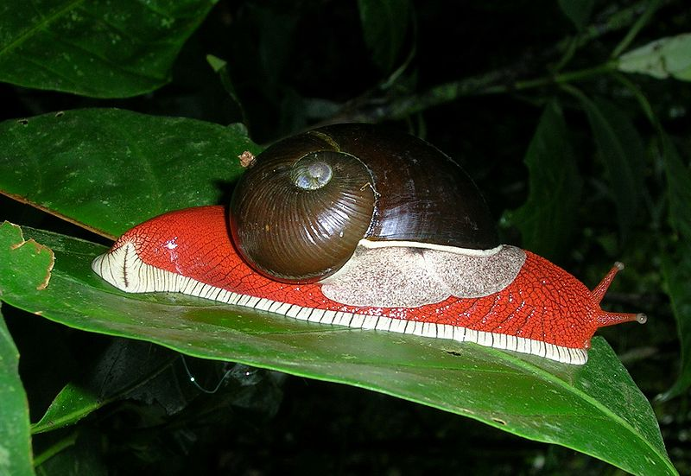
SNAIL

Slide 16
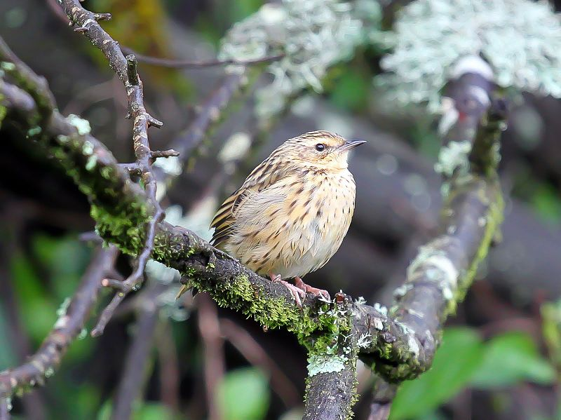
NILGIRI PIPET

Slide 17
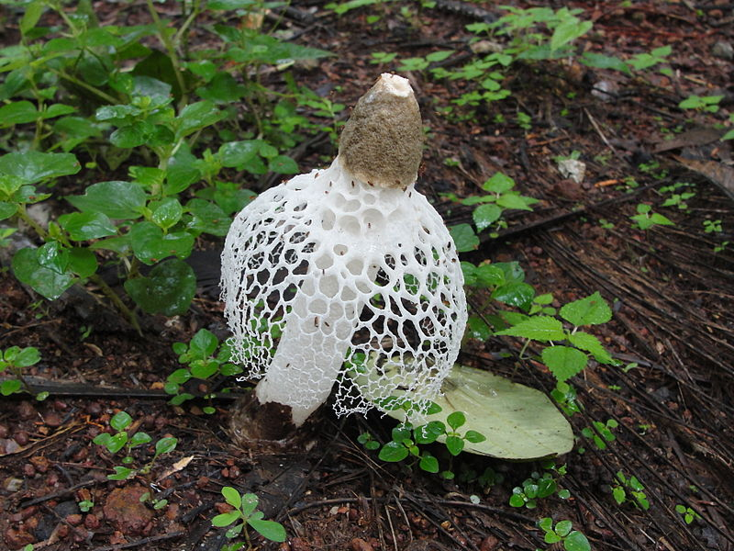
PHALUS INDUSIATUS

Slide 18
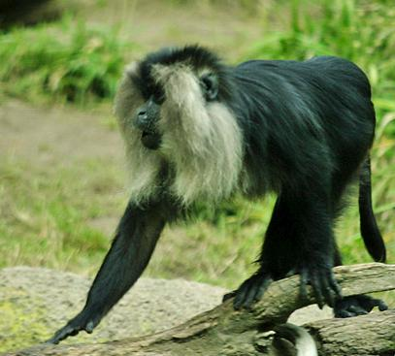
LION-TAILED MACAQUE

Slide 19
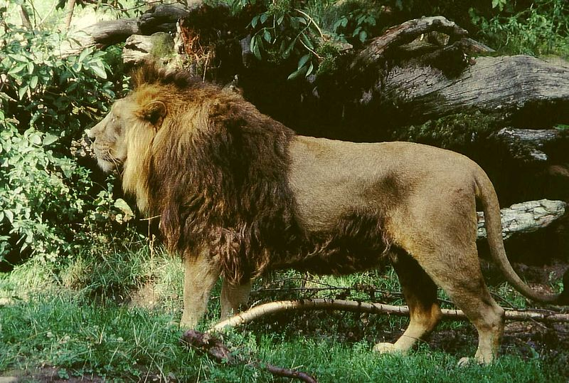
ASIATIC LION

Slide 20
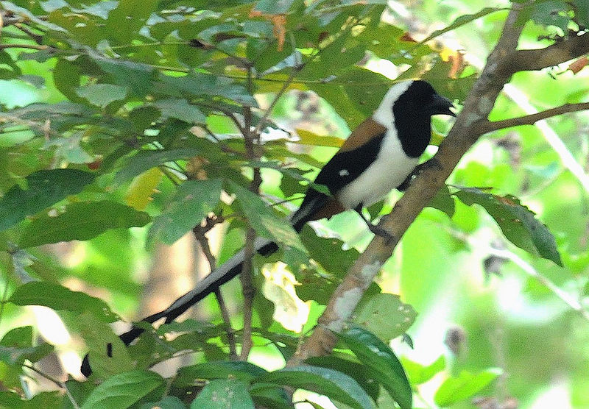
WHITE-BELLIED TREPIE

Slide 21
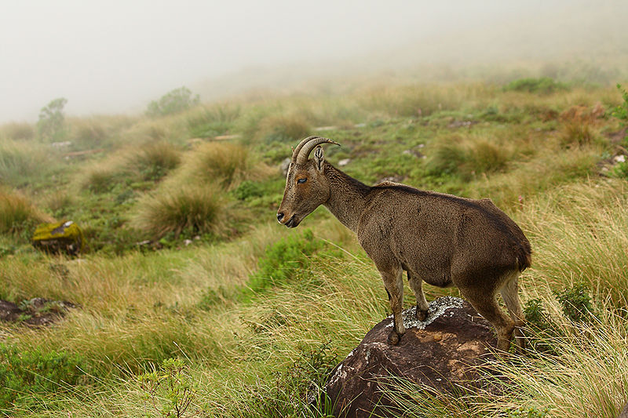
NILGIRI TRAGUS---MOUNTAIN GOAT

Slide 22
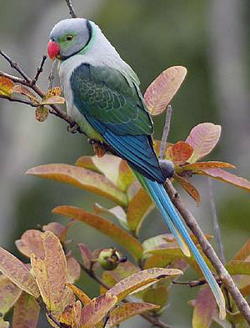
MALABAR PARAKEET

Slide 23
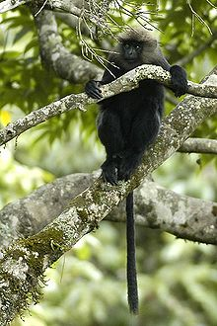
NILGIRI LANGUR

Slide 24
NORTH EASTERN HIMALAYAS
IT LIES BETWEEN KALI GANDAKI RIVER IN CENTRAL NEPAL AND MYANMAR IN THE EAST, OCCUPYING 2MILLION SQUARE KM OF TROPICAL ASIA,EAST OF THE INDIAN SUBCONTINENT.
IN INDIAN REGION,IT STARTS FROM SIKKIM AND EXTENDS UPTO NEFA.
APPROAXIMATELY,13,500 PLANT SPECIES ARE REPORDED,OUT OF WHICH 7,000 SPS ARE ENDEMIC.
2,185 SPECIES OF TERRESTRIAL VERTEBRATES ARE RECORDED,OUT OF WHICH 525 ARE ENDEMIC.

Slide 25
IT HAS THE HIGHEST DIVERSITY OF FRESH WATER TURTLE SPECIES.
THE MOUNTAIN SLOPES HAVE HIGH RAINFALL, MOISTURE AND TEMPERATURE.HENCE,TROPICAL MOIST EVERGREEN FORESTS,BAMBOOS,GRASSES OF DIFFERENT TYPES,INSECTIVOROUS PLANT LIKE “NEPENTHES KHASIANA”—FLAG SPECIES, ARE GROWING ABUNDANTLY.
8,000SPS. OF FLOWERING PLANTS ARE PRESENT,OF WHICH 3,000 ARE ENDEMIC.
IN SIKKIM AREA,4,250 FLOWERING PLANTS ARE FOUND OUT OF WHICH 2,550 ARE ENDEMIC.
IN THIS AREA,MAXIMUM DIVERSITY IS FOUND AMONG ORCHIDS,RHODODENDRONS,OAKS,FERNS, ZINZIBERS etc.

Slide 26
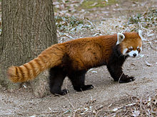
RED PANDA

Slide 27

GIANT PANDA

Slide 28
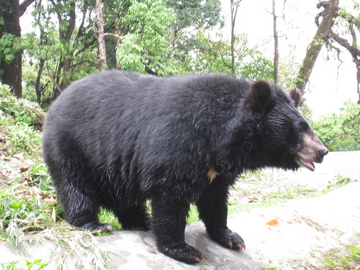
HIMALAYAN BEAR

Slide 29
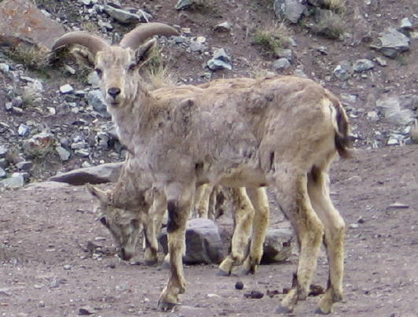
HIALAYAN BLUE SHEEP

Slide 30
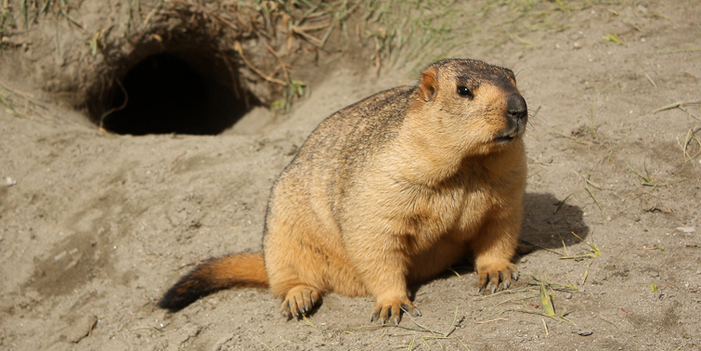
HIMALAYAN MARMOT

Slide 31
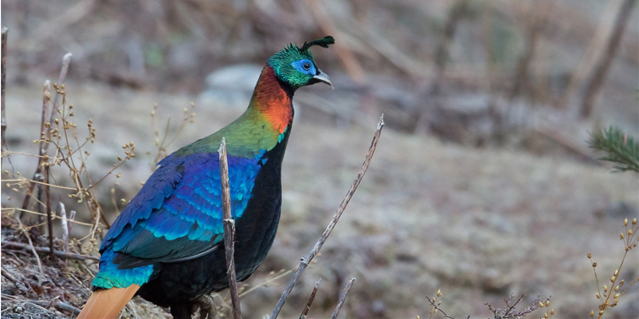

Slide 32
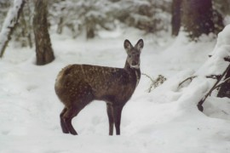
MUSK DEER

Slide 33
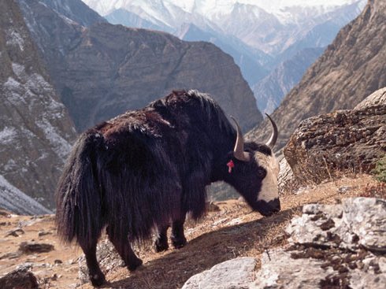
HIMALAYAN YAK

Slide 34
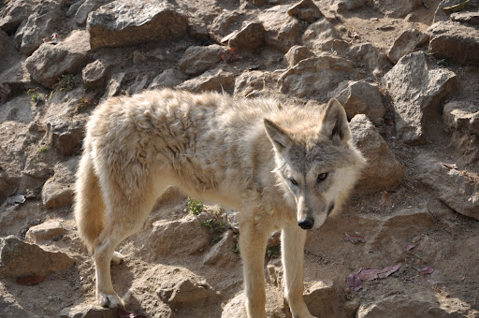
HIMALAYAN WOLF

Slide 35
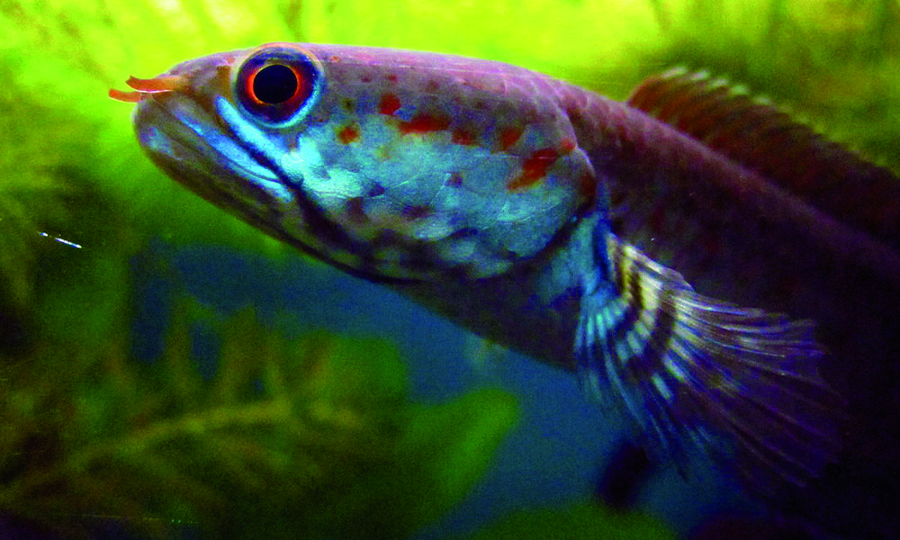
DWARF SNAKE HEADED FISH

Slide 36
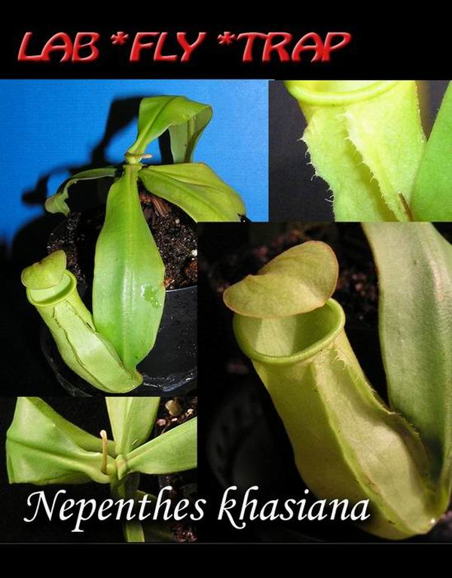
NEPENTHES KHASIANA

Slide 37
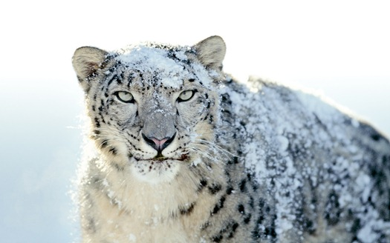
SNOW LEOPARD

Slide 38
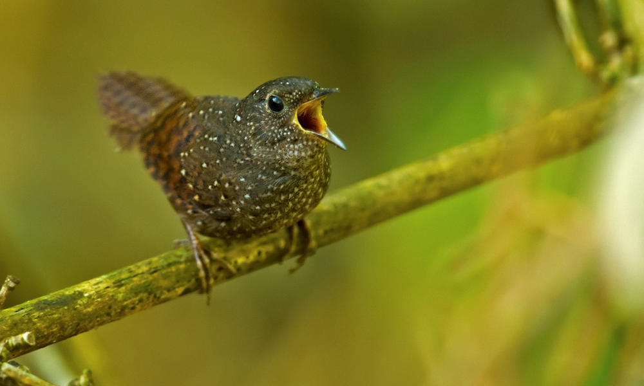
DWARF WREN BABBLER

